Slide 1
Writing Paragraphs
A distinct division of written or printed matter that:
begins on a new, usually indented line,
consists of one or more sentences, and
typically deals with a single thought or topic or quotes one speaker's continuous words.

Slide 2
These are the essential parts in a paragraph.
Topic
Main Ideas
Supporting Details
Notes:
Just as a sentence has essential parts, a subject and a verb, a paragraph has essential parts. The first is a topic. Every paragraph is about something. The topic, or subject, is what the paragraph tells about. Every paragraph also needs a main idea. This is the general and most important idea that the paragraph discusses about the topic. Most authors of non-fiction material, like textbooks, state their main ideas. But they don’t always; main ideas may sometimes be implied, or unstated. Supporting details are sentences that prove, support, or give more information about the main idea.

Slide 3
When to Break Paragraphs
Change of Topic
  I love spending time outdoors. The beach is my favorite place to relax, where I can unwind and listen to the soothing sound of the waves. The smell of saltwater and the warmth of the sun on my skin are exhilarating. I often take long walks along the shore, collecting seashells and observing the marine life. It's a perfect way to clear my mind and recharge.
  However, hiking in the mountains provides a unique sense of adventure. The challenging terrain and breathtaking views from the summit make every hike an unforgettable experience. I enjoy exploring new trails, discovering hidden waterfalls, and marveling at the diverse flora and fauna. The sense of accomplishment when reaching the top is unparalleled.

Slide 4
When to Break Paragraphs
Introduction of a New Point or Idea
  The benefits of regular exercise are well-documented. Exercise improves physical health, boosts mood, and enhances cognitive function. Regular physical activity reduces the risk of chronic diseases, increases energy levels, and promotes better sleep. Many people struggle to maintain a consistent exercise routine due to lack of motivation or time.
  One often overlooked advantage of exercise is improved mental clarity and focus. Physical activity stimulates blood flow to the brain, enhancing concentration and productivity. Exercise also reduces stress and anxiety by releasing endorphins, also known as "feel-good" hormones. By incorporating exercise into daily routines, individuals can experience significant mental benefits.

Slide 5
When to Break Paragraphs (cont.)
Change in Time/Setting
I grew up in a small town surrounded by nature, where everyone knew each other's names. My childhood was filled with outdoor activities like fishing, camping, and exploring the nearby woods. The simplicity and tranquility of small-town life shaped my values and personality. I cherish the memories of family gatherings, community events, and lazy summer afternoons.
Years later, I moved to the city for college and discovered a new world of opportunities. The fast-paced urban environment was overwhelming at first, but I soon adapted and thrived. I was exposed to diverse cultures, cutting-edge technology, and vibrant art scenes. The city taught me to be resilient, resourceful, and open-minded.

Slide 6
When to Break Paragraphs (cont.)
Contrast or Opposition
  I enjoy the peace and quiet of reading alone, immersing myself in fictional worlds and learning from non-fiction works. Reading helps me escape reality, relax, and expand my knowledge. I appreciate the flexibility of reading at my own pace, re-reading favorite passages, and making notes. Solo reading allows me to reflect on my thoughts and emotions without distraction.
  On the other hand, discussing books with friends in a book club provides valuable insights and perspectives. Sharing thoughts and opinions with others enriches my understanding of the material and fosters meaningful connections. Book clubs encourage critical thinking, empathy, and social interaction.

Slide 7
Logical bridges (Coherence)
Verbal bridges (Cohesion)
The same idea of a topic is carried over from sentence to sentence
Successive sentences can be constructed in parallel form
Repeat key words
Use synonyms
Use Pronouns
Use transition words to link ideas from different sentences
Coherence and Cohesion are traits which make a paragraph easily comprehensible.

Slide 8
How to Unify Paragraphs
Develop a single idea.
Use topic sentences that state the main idea of the paragraph.
Other sentences should support the idea expressed in the topic sentence.
For support, use examples, data, or logical progression.

Slide 9
Example of Unified Paragraph
(topic sentence at beginning—the most common method)
Renewable energy sources, such as solar, wind, hydro, and geothermal power, offer numerous benefits for the environment, economy, and human health. By harnessing energy from natural resources, renewable energy reduces greenhouse gas emissions, mitigating climate change and air pollution. According to the International Energy Agency (IEA), renewable energy accounted for 26% of global electricity generation in 2020, up from 21% in 2015. Moreover, renewable energy creates jobs, stimulates local economies, and enhances energy security by reducing dependence on fossil fuels. The cost of renewable energy technologies, such as solar panels and wind turbines, has decreased significantly over the years, making them more competitive with fossil fuels. In fact, a study by the National Renewable Energy Laboratory (NREL) found that widespread adoption of renewable energy could reduce global carbon emissions by 78% by 2050.

Slide 10
Another Example
(topic sentence at end)
Studies have consistently shown that cities with high levels of walkability and bikeability experience reduced rates of obesity and related diseases. For instance, a study published in the Journal of the American Medical Association found that residents of New York City's most walkable neighborhoods were 30% less likely to be obese than those living in less walkable areas. Similarly, Copenhagen's investment in bike infrastructure has led to a 20% increase in commuting cyclists, resulting in improved air quality and reduced healthcare costs. In Barcelona, the introduction of 'superblocks' – pedestrian-friendly zones restricting vehicle access – has decreased air pollution by 25% and increased physical activity among residents. These examples suggest that urban design prioritizing pedestrian-friendly and bikeable infrastructure can have a significant impact on public health, pointing to the conclusion that designing cities for walkability and bikeability is essential for promoting healthier communities.

Slide 11
Writing Coherent Paragraphs
Organize paragraphs appropriately.
Use transitional words and phrases between paragraphs and sentences, if necessary.

Slide 12
Paragraph Without Transitions
The city's transportation system is outdated. It causes traffic congestion and air pollution. Many residents rely on personal vehicles. This leads to increased emissions and decreased air quality. The city's population is growing. New solutions are needed. Innovative transportation systems can reduce emissions.

Slide 13
Paragraph With Transitions
The city's transportation system is outdated, resulting in traffic congestion and air pollution. Consequently, many residents rely on personal vehicles, which leads to increased emissions and decreased air quality. Furthermore, the city's growing population exacerbates this issue. Therefore, new solutions are needed to address this problem. In fact, innovative transportation systems can significantly reduce emissions, providing a healthier environment for residents.

Slide 14
Frequently Used Transitions
To Signify Sequence or Addition
again, also, besides, first . . .second . . .third, furthermore,
In addition, moreover, one . . . another, too
To Signal Time
afterward, as soon as, at first, at the same time, before, earlier,
finally, in the meantime, later, meanwhile, next, now, soon,
subsequently, then, until
To Signal Comparison
also, by the the same token, in comparison, likewise, similarily
To Signal Contrast
although, but, despite, even though, however, in contrast, instead,
Meanwhile, nevertheless, nonetheless, on the contrary, on one hand . . .
on the other hand, still, whereas, yet, conversely

Slide 15
More Transitions
To Introduce Examples
for example, for instance, namely, specifically, thus
To Signal the Narrowing of Focus
after all, indeed, in fact, in other words, in particular, specifically, that is
To Introduce Conclusions or Summaries
as a result, consequently, in conclusion, in other words, in summary
therefore, thus, to conclude, finally
To Signal Concession to Another Perspective
admittedly, certainly, granted, naturally, of course
To Introduce Causes or Effects
accordingly, as a result, because, consequently, hence, since, so, then, therefore

Slide 16
Approaches to Paragraph-writing
Inductive Approach
Begins with the evidence/reasons/sub-claims leading to the statement of the writer’s claim or the central argument at the end of the paragraph
Conclusion-oriented
Deductive Approach
The claim or central argument is usually provided in the first sentence of the paragraph
The rest of the paragraph provides evidence and reasons/sub-claims supporting the initial claim

Slide 17
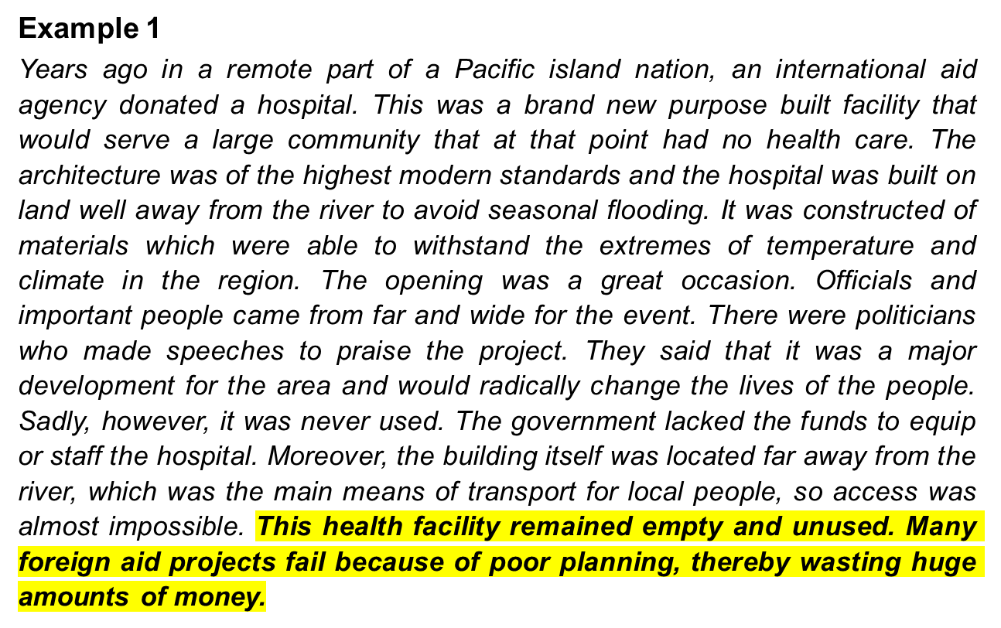
Approaches to Paragraph-writing

Slide 18
Approaches to Paragraph-writing
Example 1
The paragraph uses inductive approach, starting with sub-claims and building up to the main idea, which is summarized in the final sentence. The central argument of the paragraph is revealed in the concluding sentence.

Slide 19
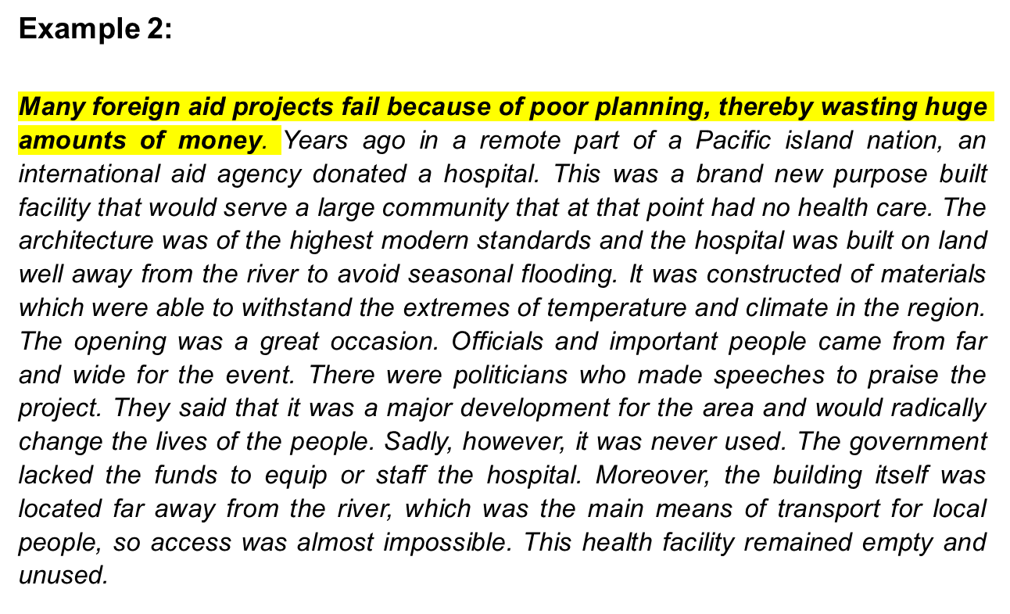
Approaches to Paragraph-writing

Slide 20
Approaches to Paragraph-writing
Example 2
The paragraph uses deductive approach as the central argument or main claim of the paragraph is presented in the first sentence. The paragraph then provides evidence, reasons and supporting sub-claims to reinforce this main claim.

Slide 21
Conclusion
Any Questions?

